Slide 1
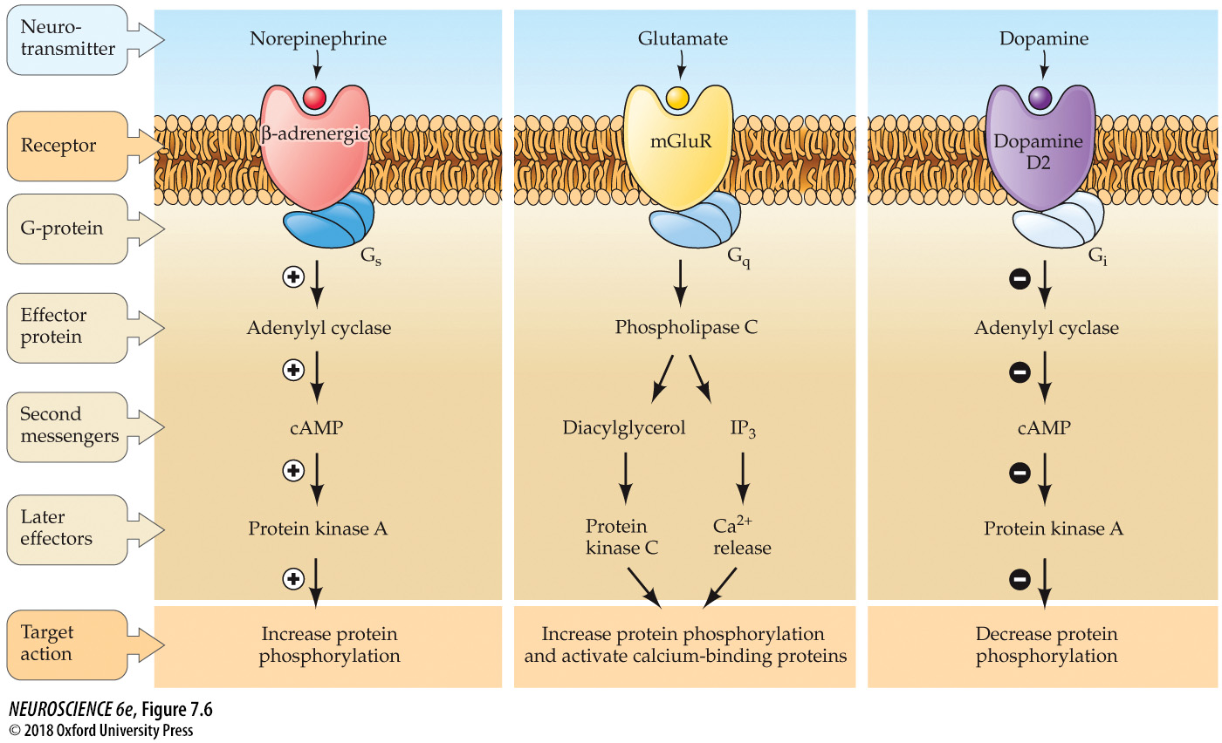
Late effectors

Slide 2
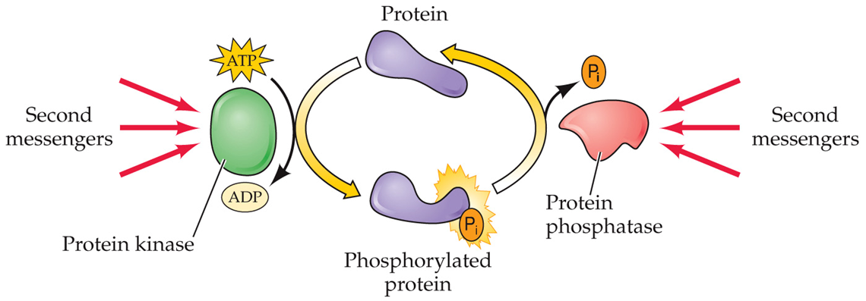
Kinase
Cellular function is largely regulated through modulating the phosphorylation state of intracellular proteins (Driven primarily by activity of 2nd messengers)
Phosphatase
an enzyme that adds phosphate groups (PO₄³⁻) to other molecules.
an enzyme that removes phosphate groups (PO₄³⁻) from other molecules.

Slide 3
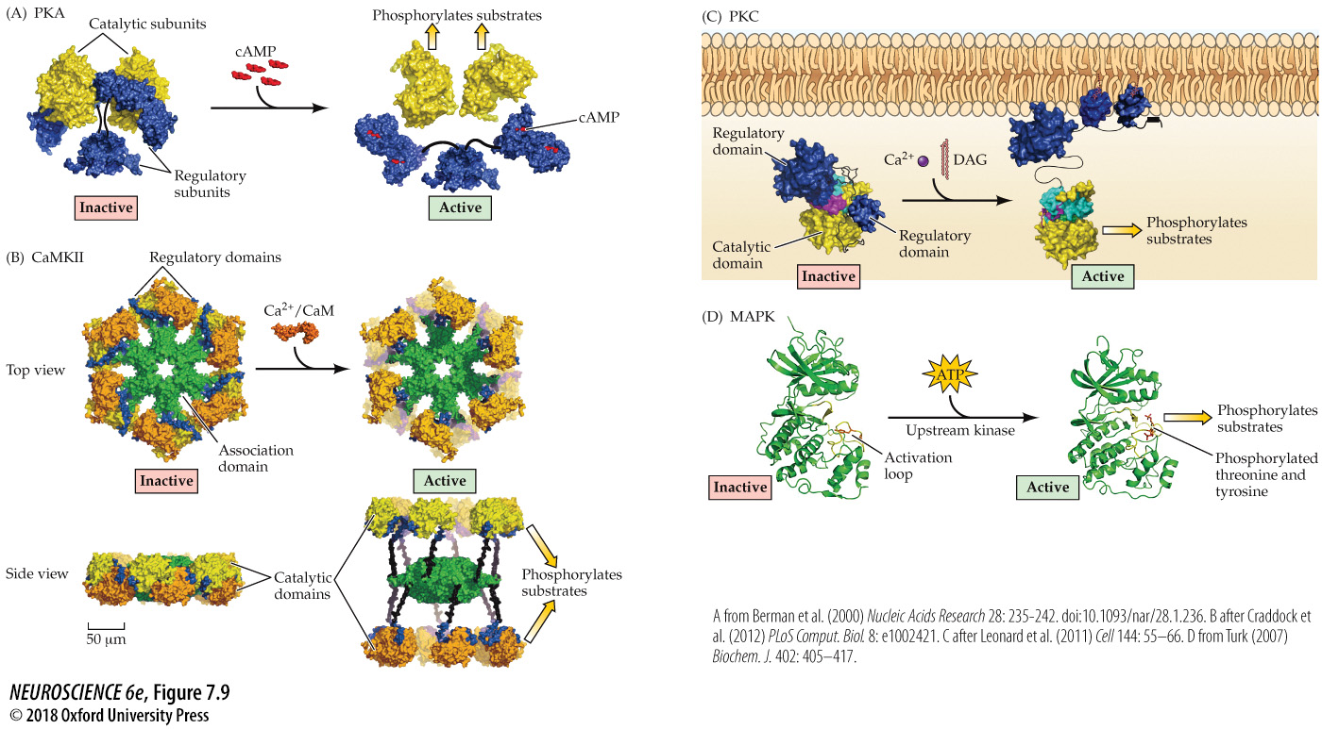
All kinases work about the same
They are held inactive by regulatory regions
2nd messenger binding to the regulatory region releases the catalytic region
The kinase is now able to catalyze the phosphorylation of specific amino acids

Slide 4
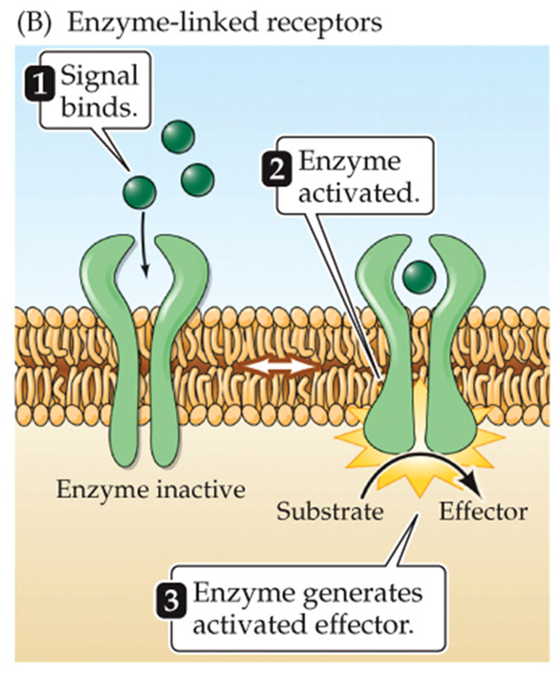
Receptor Tyrosine Kinase

Slide 5
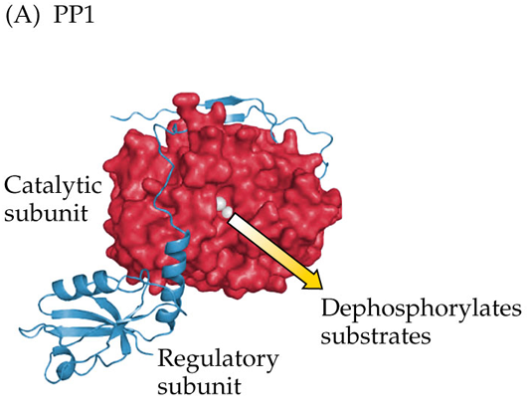
Protein Phosphatases
Similar structures as Kinases.
Less substrate specificity compared to kinases
Most regulatory subunits do not bind to 2nd messengers.
Dephosphorylation depends on where the phosphatase is located and which regulatory subunits are active

Slide 6
Nuclear Signaling

Slide 7
Nuclear Signaling
Kinases can elicit prolonged changes by activating transcription factors and, thereby, influencing RNA synthesis and protein synthesis.
  Changes are slow: 60+ mins
  Reversal of changes can take hours to days
    Changes can be permanent
3 key transcriptional activator proteins (aka, transcription factors) include:
  CREB
  c-fos
  Nuclear receptors

Slide 8
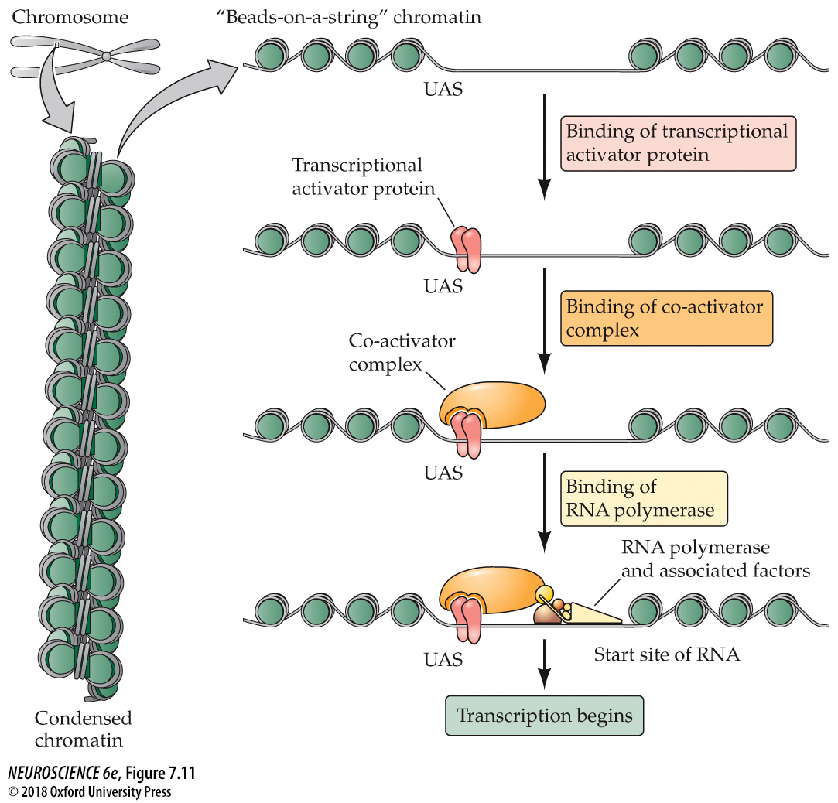
RNA Synthesis
Decondensation of the structure of chromatin
Reveals cites for transcription factor (TF) binding
TF binds near the start of the gene sequence
A co-activator complex binds to the TF to promote the unwrapping of the DNA
Then the RNA polymerase (and associated factors) binds to the co-activator complex
This initiates transcription
Intracellular signal transduction cascades regulate gene expression by converting TFs from an inactive state to an active state in which they bind to DNA.

Slide 9
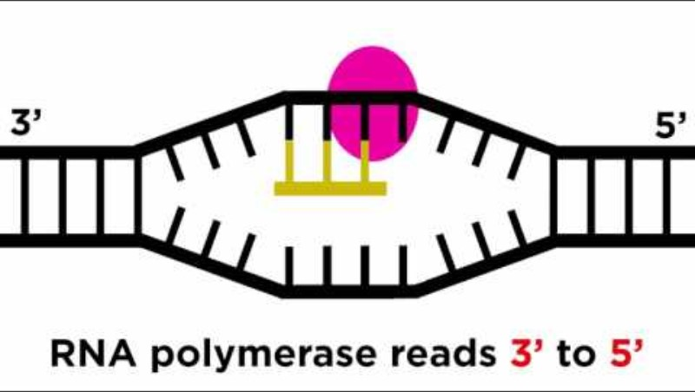
RNA Transcription and Translation
Notes:
https://www.youtube.com/watch?v=bKIpDtJdK8Q

Slide 10
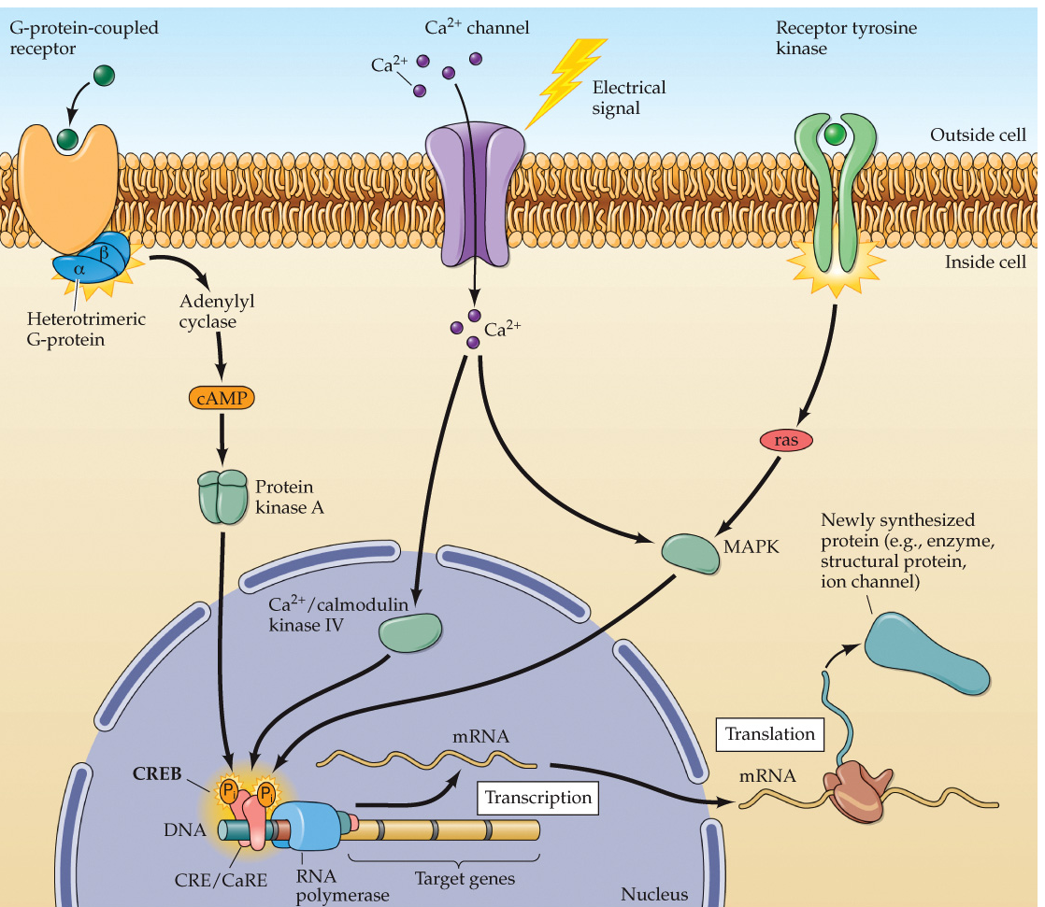
CREB
CREB is typically bound to its binding site on DNA (inactive)
It can be phosphorylated (activated) by multiple kinases
  Kinases can also enhance CREB transcriptional activity indirectly through inhibition of phosphatases
CREB-sensitive genes include: c-fos, BDNF, TH, many neuropeptides

Slide 11
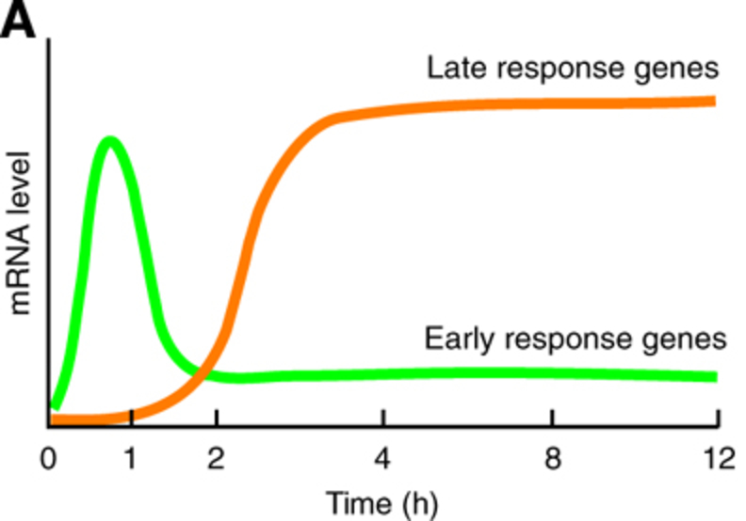
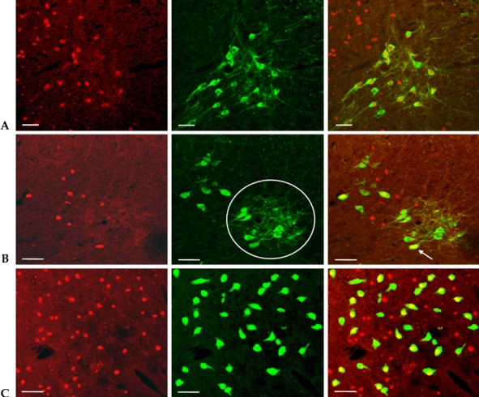
c-fos
Delayed
Early Immediate
An immediate early gene & a transcription factor
Activation of a cell causes c-fos levels to rise dramatically in ~60 min
Regulatory region has multiple binding sites
Once activated c-fos can stimulate second order genes (delayed response genes)

Slide 12
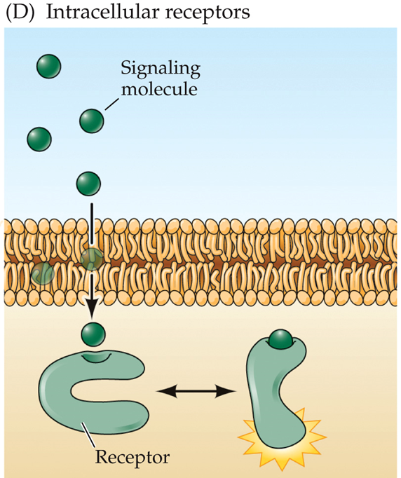
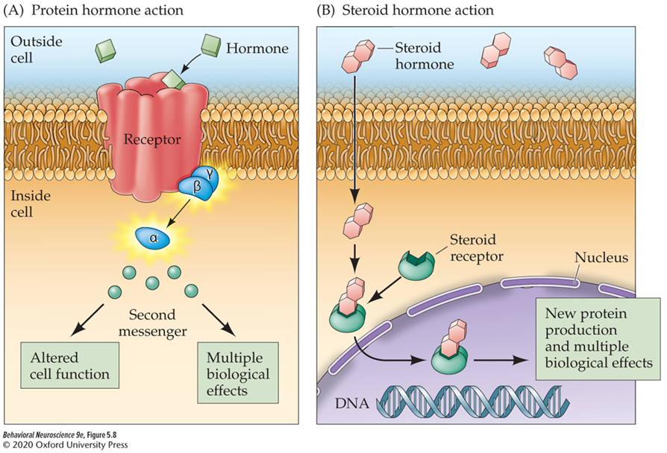
Nuclear Receptors
Nuclear receptors are not membrane bound.
Membrane permeant ligands (mostly steroid hormones) can pass though the cell membrane and bind with nuclear receptors.
Bound ligands create a ligand-receptor complex that binds specific regions of DNA where it acts as a transcription factor.

Slide 13
Common Intracellular signaling cascade Examples

Slide 14
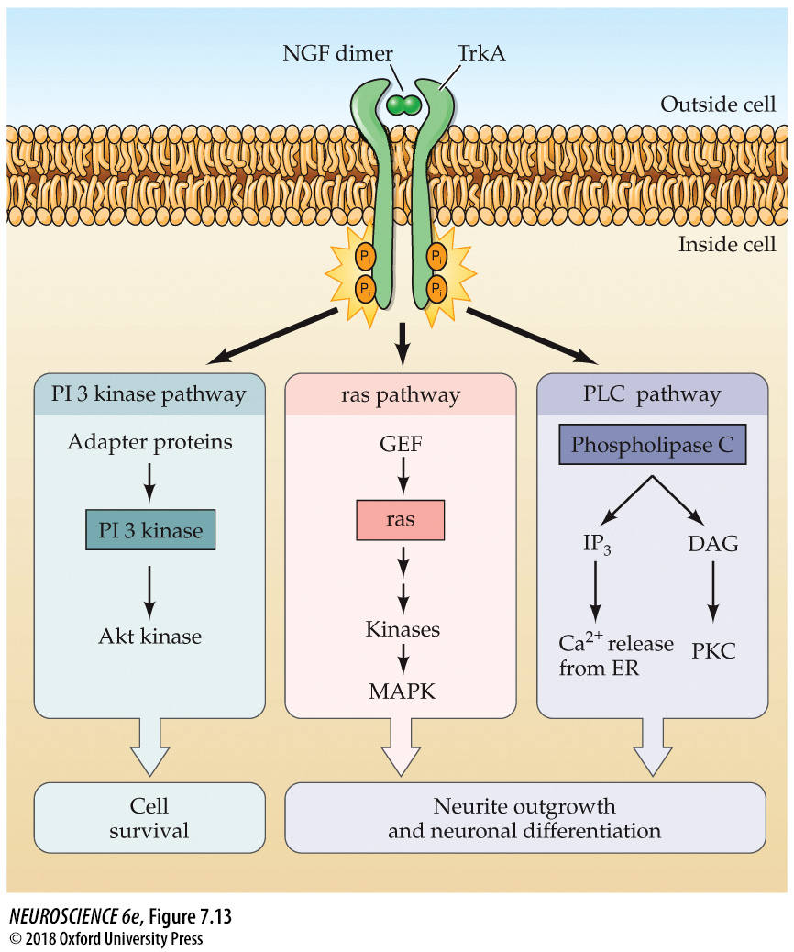
NGF Pathways
Neurotrophic growth factor (NGF)
Binds an RTK (TrkA)
  Binding triggers RTK dimerization & cross phosphorylation
  the multiple phosphorylated sites act to initiate multiple pathways.
    Ras pathways – cell differentiation
    PLC → IP3 & DAG
    PI3 Kinase pathway – cell survival

Slide 15
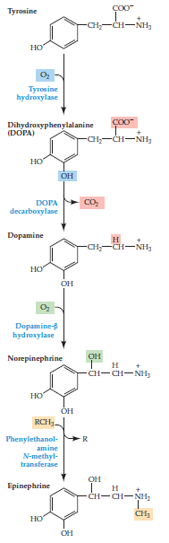
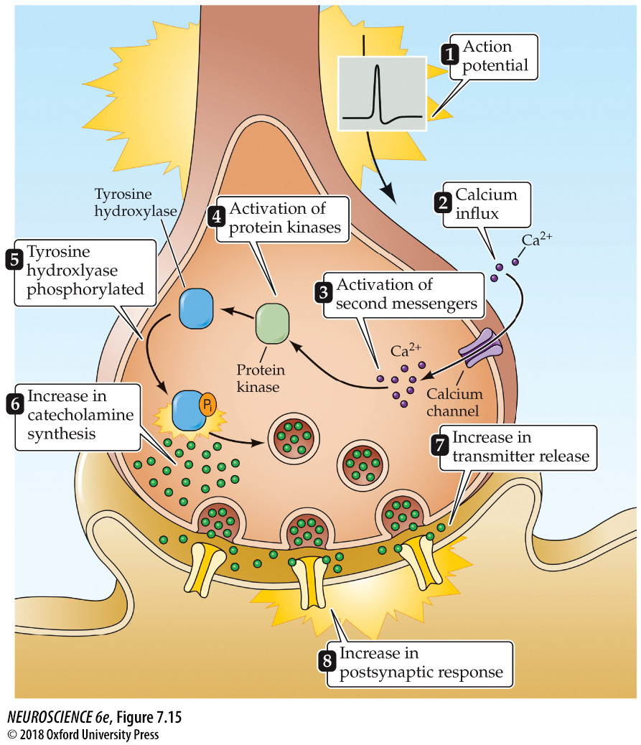
Regulation of Tyrosine hydroxylase (TH)
Can be phosphorylated by: PKA, PKC, and CaMKII
  These are all activated by Ca²⁺
Phosphorylation changes TH conformation and increases it catalytic activity
Allowing an increase in catecholamine synthesis

Slide 16
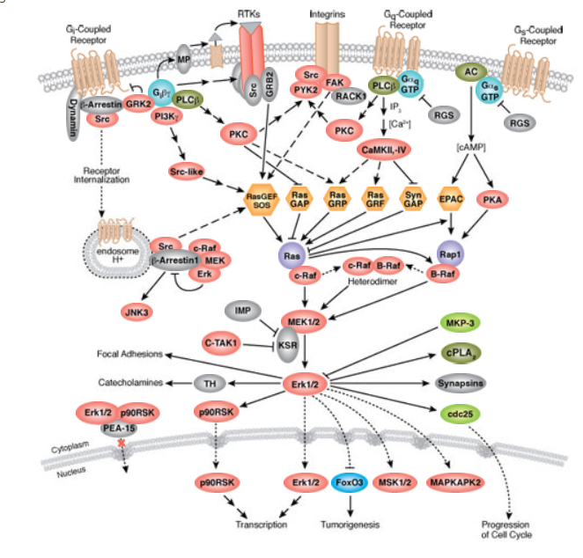
And it is all happening simultaneously within our neurons!

Slide 17
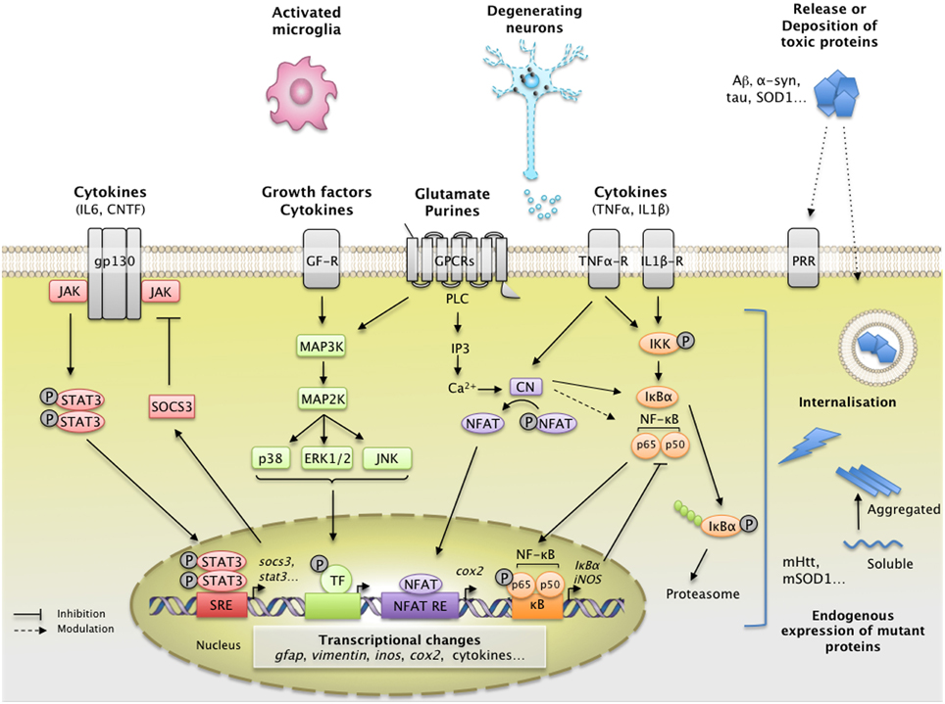
And not just in neurons …

